Slide 1


CAPSTONE 1 DEFENSE
Green Big5 Information System
Danang, December 2021
Notes:
Welcome everyone, It’s a great honor to have you here in this room, today my teammate and I will report on a scientific research topic. The name of that group project is: Green Big 5 Information System

Slide 2
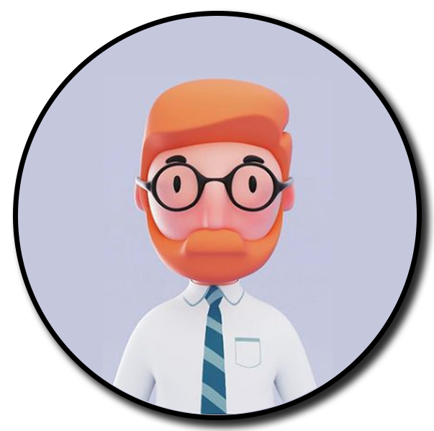
Team C1SE.02
Name: Binh Thanh Nguyen
Role: Mentor
Contact: ttb_2001@yahoo.com
International School at Duy Tan University
Name: Chinh Thai huu
Role: Team Leader / Developer
Contact: huuchinhdev@gmail.com
Class: K24CMU-TPM3
Name: Hau Bui Phuc
Role: UI/UX Designer / Developer
Contact: bphau121020@gmail.com
Class: K24CMU-TPM3
Name: Chung Hoang Bao
Role: Secretary / Developer
Contact: baochunga1@gmail.com
Class: K24CMU-TPM3
Name: Loc Nguyen Tien
Role: Developer
Contact: tienloc18122k@gmail.com
Class: K24CMU-TPM3
Notes:
The man who make this topic become true:
mentor : Doctor. Habil Nguyen Thanh Binh
scrum master: Chinh, Thai Huu
developer:Chinh, Thai Huu, Chung, Hoang Bao, Hau, Bui Phuc, Loc, Nguyen Tien

Slide 3

Capstone project I
SMART DASHBOARD APPLICATION
Team: C1SE-06
Mentor:
PhD Binh Nguyen Thanh
MSc Huy Truong Dinh
Scientific Research Report
Green Big5 Information System
Team: C1SE.02
Mentor:
Doctor. Habil Binh Nguyen Thanh
Notes:
The overview of this topic
Building a system to collect user data with questions from which to analyze personality based on the Big5 model there by finding the relationship between personality and user's impact on the environment

Slide 4
Table of contents
Main content:
1. Idea
2. Product
3. Technologies Stack
4. Demo
5. Summary
Idea
Application
Technologies Stack
Our Product
Notes:
These are the main contents that will be presented: Idea, Product, Technology stack and demonstration of this project

Slide 5
Idea
Notes:
In this part, I will talk about some problem that make our idea.

Slide 6
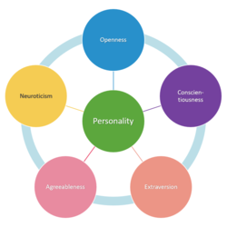
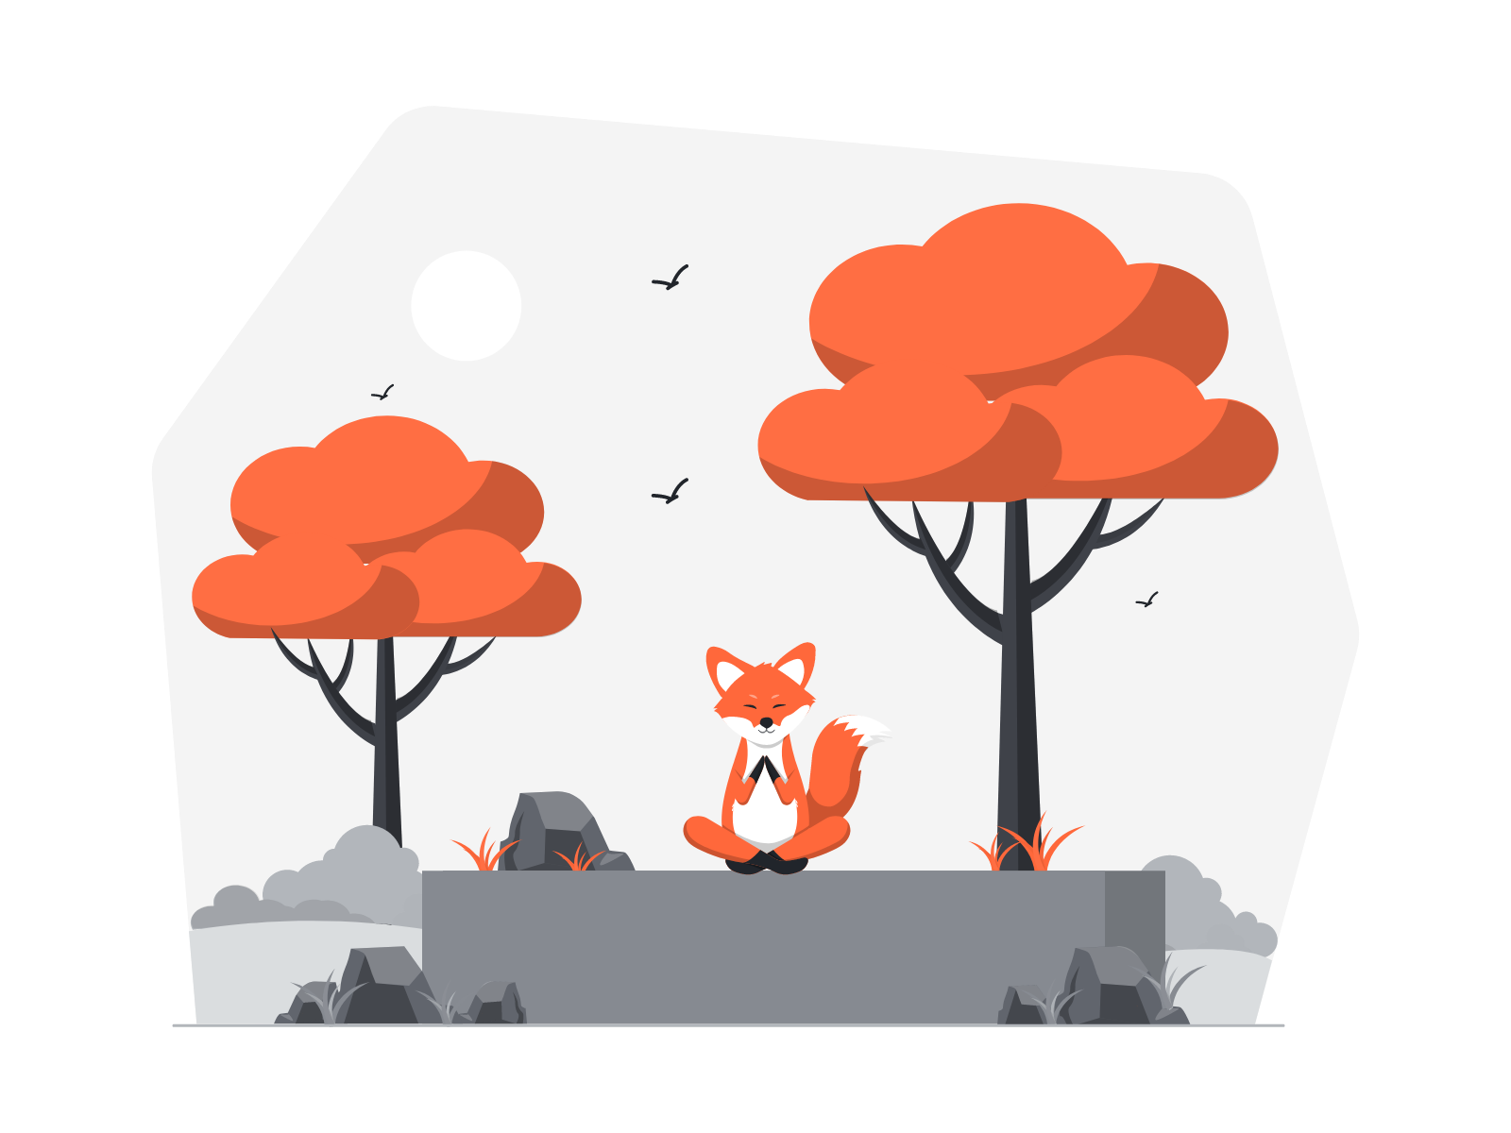
Table of contents
Main content:
1. Idea
2. Product
3. Technologies Stack
4. Demo
5. Summary
Environment State
The environmental problem is the most concerning problem not only in Viet Nam but the World as well. This problem is caused by human development as well as civilization.
Personality and environment impact
Big5(O.C.E.A.N) model
Big5 model, known as O.C.E.A.N model, is a psychological model researched and developed by many scientists around the world.
Openness to knowledge
/experience
Conscientiousness
According to many searches around the world, they found that there is a collaboration between Human personality and the environmental impact
Extraversion
Agreeableness
Neuroticism
Notes:
Environment State: The environmental problem is the most concerning problem not only in Viet Nam but the World as well. This problem is caused by human development as well as civilization.
According to many kinds of research around the world, they found that there is a collaboration between Human personality and the environmental impact.In those researches, we found some talk about the collaboration between human personality traits in the Big 5 model and the environmental impact. So What is the Big 5 model?
The big5 model, known as the O.C.E.A.N model, is a psychological model researched and developed by many scientists around the world. Five factors of the Big5 model are Openness to knowledge/ experience (O), conscientiousness (C), extraversion (E), agreeableness, and neuroticism.
By following all of this we start to build a system to collect user data with questions from which to analyze personality based on the Big5 model thereby finding the relationship between personality and user's impact on the environment

Slide 7

Definition
Big5 Data collection Scenario
Providing the questions/ answers route
Set-up rule sends the question to a specific user’s group
Help the system have a specific for classifile user personality trait
Big5 Indicator
The Big5 indicators are the characteristics, a sign of presence or absence of one or many Big5 traits.
Notes:
Before we go to the Big5 formula. I would like to introduce some definition u can be meet in this project.

Slide 8
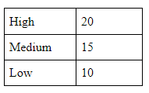
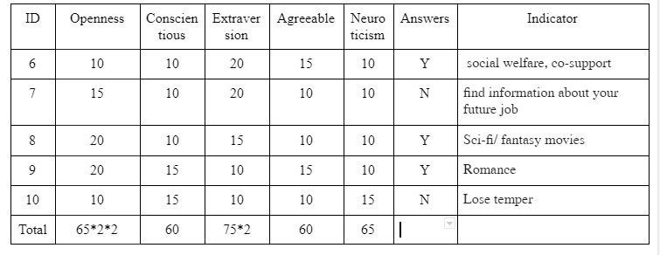
Calculating Big5 Formula
+ Medium and Low Trait point = ⅀( the trait point in each indicator)
+ High Trait point = ⅀( the trait point in each indicator) *2^(number of indicator that have been answered “YES”)
Notes:
This I talk about the Big5 Formula which my team and I have been making during our research about it.
Let me give you an example: Here I have 5 indicators and the answers you can see on the screen. First, I will add all the feature points in the Openness column. Then in the answers column, we have 3 "yes" answers but only 2 have "high" in the openness trait, so I multiply 2 for the openness trait 2 times

Slide 9
Concept of this project
Question/ Answer
Direacting
Interacting
Big5 Prediction
Indicator
Calculating
Notes:
As you can see on the screen here is our concept of this project
First of all, The system interacts with user by sending the question and receiving answer based on the direction of the Big5 Scenario. By interact with them the system can extract information according to the app-user’s answer to calculate Indicator. Then, by calculating the Indicator user’s personality can be predicted. This repeatable life cycle can be performed multiple times to train and test the system based on the Q&A package and its workflow. As a result, the user's personality can be classified.

Slide 10
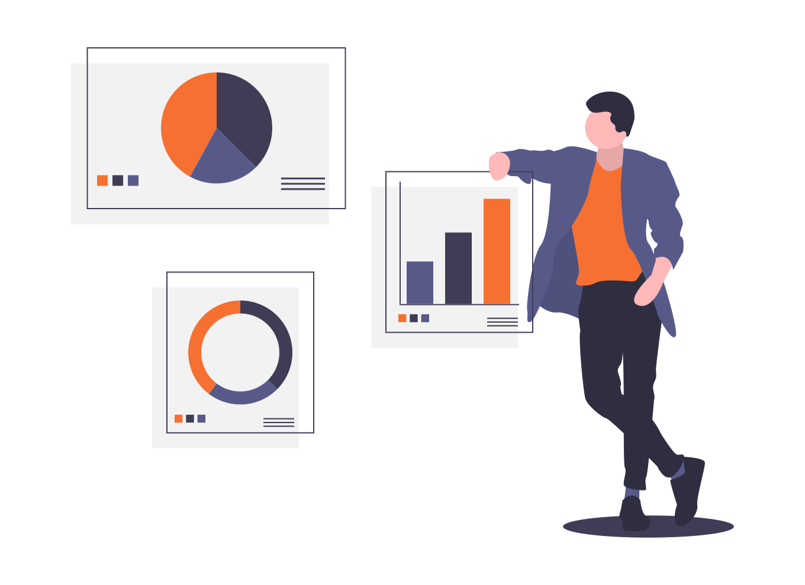
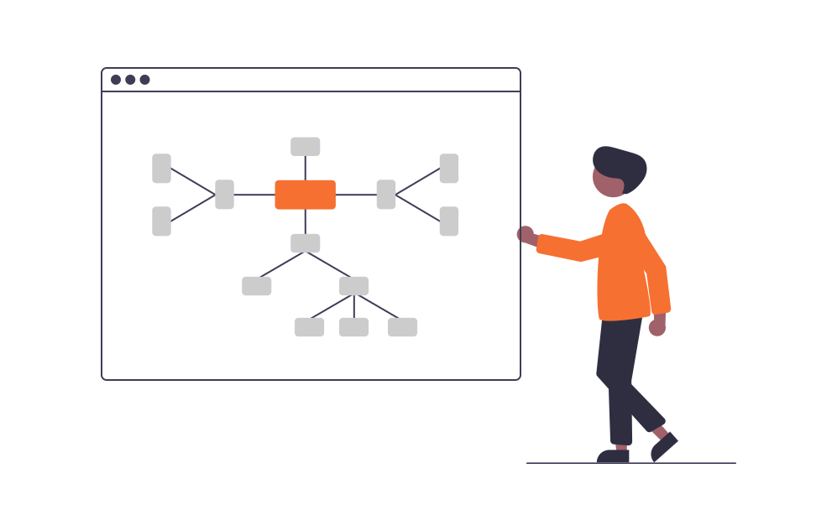
TARGET USER
Focus on not only the environmental experts,
but also the policy-makers, enterprises and who has interested in the environment.
MAKE IT EASY
Notes:
GB5 focuses on not only the environment expert but also the policy-makers as well as the government. This also fits the companies and the enterprises which would like to improve their services to fit the user without affecting the environment

Slide 11
Product
Notes:
Chinh
Next stop we talk about the product part. I would like to invite mr. Chung to talk about this
Chung
Hello everyone, Here I would like to present about the product of the project. Ok let's go

Slide 12

Table of contents
Main content:
1. Idea
2. Product
3. Technologies Stack
4. Demo
5. Summary
What we have done
Architecture
Notes:
In the product section, there will be 2 things mentioned. That's the goal, what we've done, and the architecture of the system

Slide 13

WHAT WE HAVE DONE?
Creating question
Sending question
Receiving answer
Predicting Big5
User management
Notes:
First I'll talk about what we've done. So what have we done? As you can see, we have done some main functions as above: create questions that we prepare, send questions to users, after users answer, receive questions from them. then analyze their personality and manage user information

Slide 14
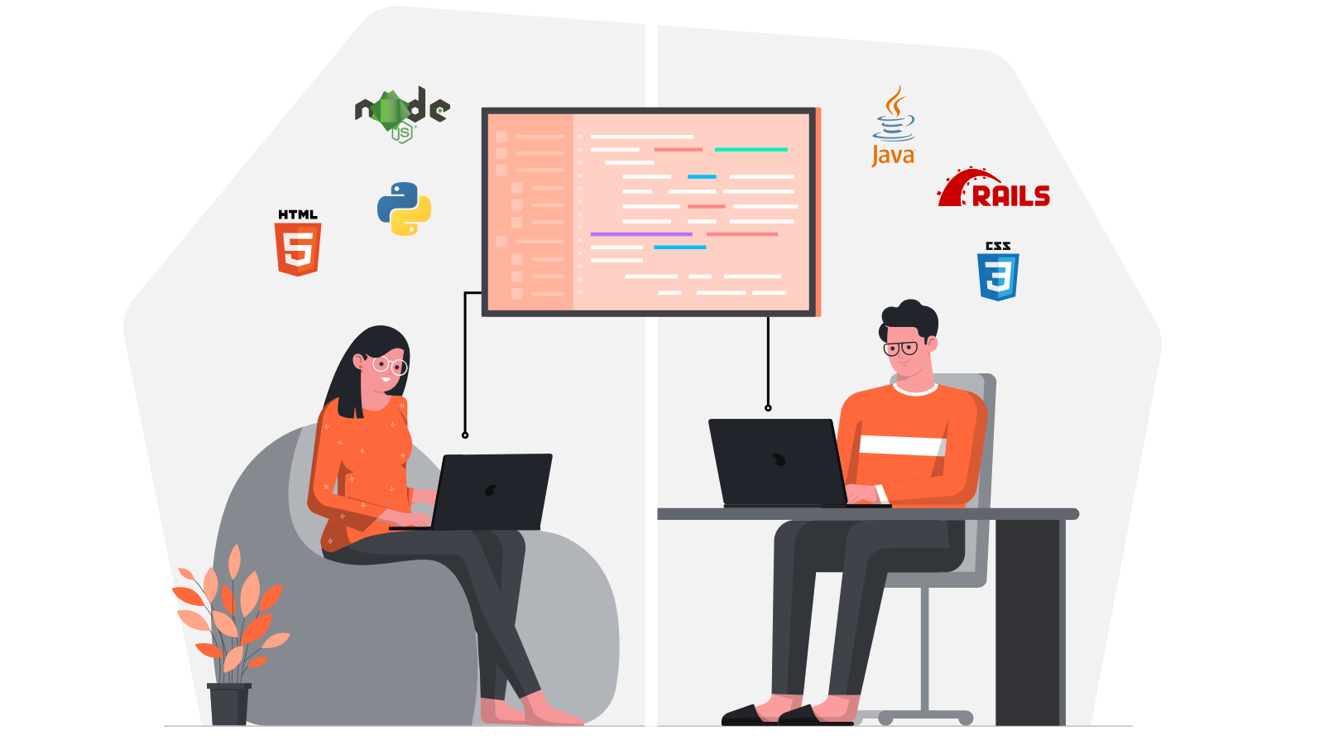
Architecture & Design
Notes:
And the important part of that product is the architecture. As everyone knows, designing an architecture is very important, it describes what the system consists of and how it works.

Slide 15
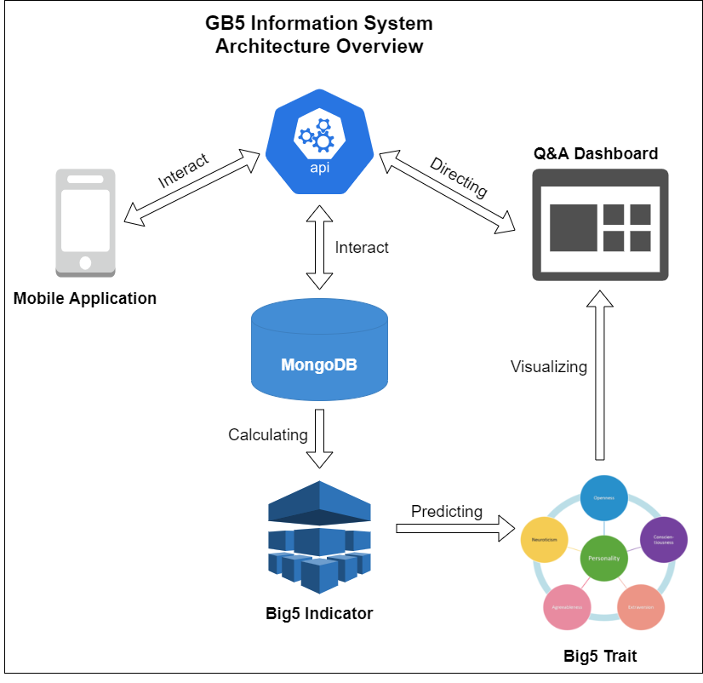
Table of contents
Main content:
1. Idea
2. Product
3. Technologies Stack
4. Demo
5. Reflection
6. Summary
System Architecture Overview
Notes:
By Sending the question and receiving the answer in the Mobile Application, the system can be calculating the Big5 Indicator through the API and the Database. With the calculated indicator, the system can predict the Big5 traits to visualize into the Q/A Dashboard. On the Dashboard, the content manager can send the next question by the direction of the Big5 scenario.

Slide 16
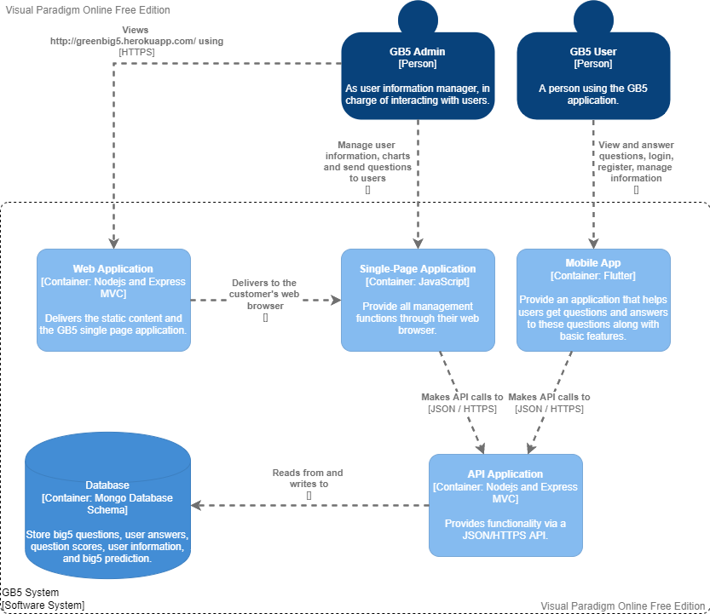
Table of contents
Main content:
1. Idea
2. Product
3. Technologies Stack
4. Demo
5. Summary
Container Diagram
Notes:
In here we have the Container Diagram. As you can see our system has two user groups.First of all, The admin manages the user's information, manages the question, and takes care of the interaction with the user that is sending the question.The next one is the user, The user uses the mobile application to receive the question and answer it. All interactions will be sent to the server through the API and database.

Slide 17
Technologies Stack
Which technologies are used ?
Notes:
Ending with architectural design we move on to Technologies Stack

Slide 18







Table of contents
Main content:
1. Idea
2. Product
3. Technologies Stack
4. Project Management
5. Demo
6. Reflection
7. Summary
PROGRAMMING LANGUAGE
Framework and development environment
Javascript
Dart
Flutter
MongoBD
… and more
Notes:
In this project we use two main programming languages which are javascript and dart. js for nodejs and dart for flutter. To build the system we also use the following technologies: nodejs for building API, back-end and Express as its framework. Pug to interact with the front-end in nodejs. Flutter for building mobile apps. And finally we use MongoDB to build the database for the system. There are also several other technologies.
This is the end of my presentation, we will see Mr. Chinh again later, he will continue to explain to everyone about project management. Welcome him back.

Slide 19
Demonstration
A live demo of our project

Slide 20
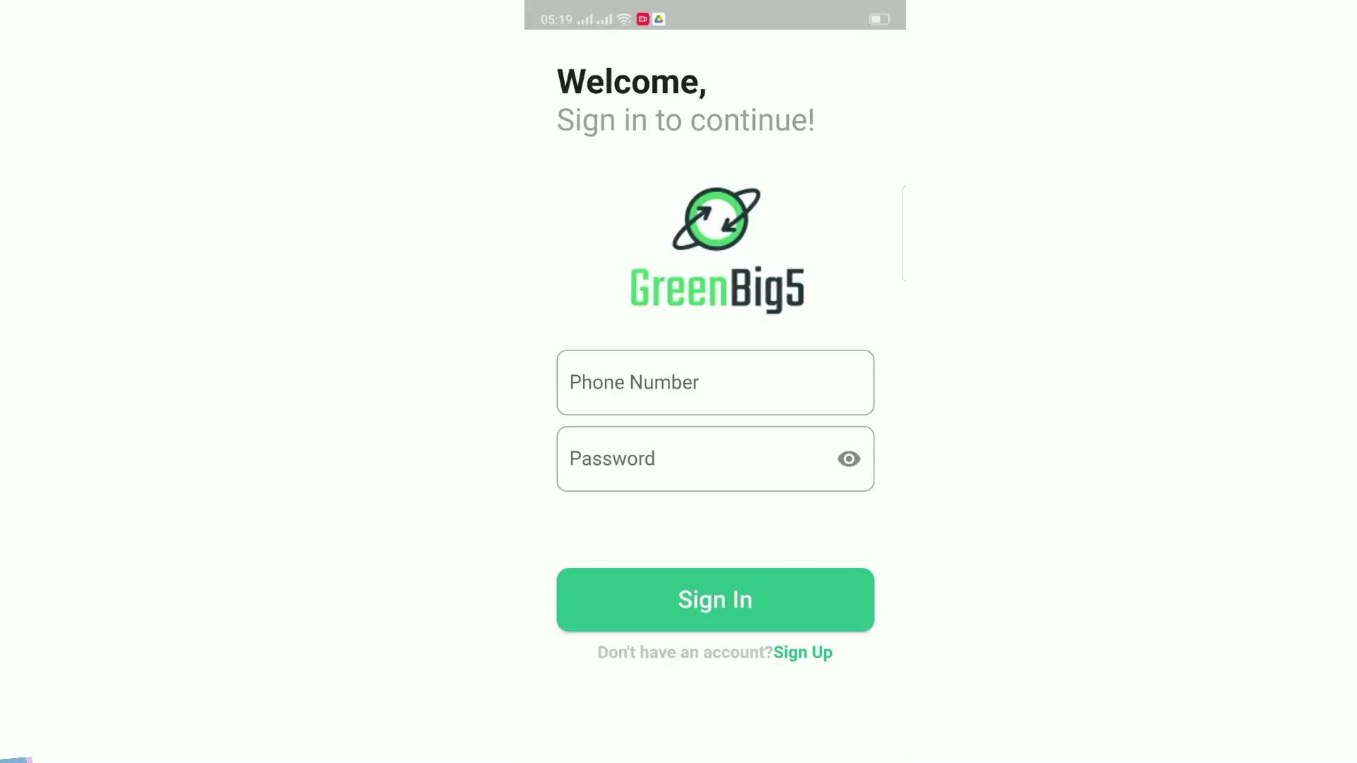
GB5 APPLICATION
Notes:
By receiving user’s answer, the system calculating the indicator to predict user’s traits as u can see in the screen
To continue the next lifecycle the admin select or can input the question and indicator
The system will automatically select the group with the characteristics of the selected question with the highest level. based on the direction in Big scenario, same level group selection system
By receiving the answer in the next lifecycle, Users can be a re-classifying personality traits.

Slide 21
Summary

Slide 22
Thank you very much
for NOT falling asleep!!!!
If you have any questions about this project
Please don’t hesitate to contact us at:
greenbig5system@gmail.com
https://github.com/dangcap99992/Capstone

